Slide 1


Selling into K-12:
Prospecting

Slide 2






Agenda
Solving Problems
Research & Preparing
Thinking Like a Marketer
Process & Diligence
Components of Winning Emails
Communication Examples
Cold Calling

Slide 3

What is your
Problem?
Solving Problems

Slide 4
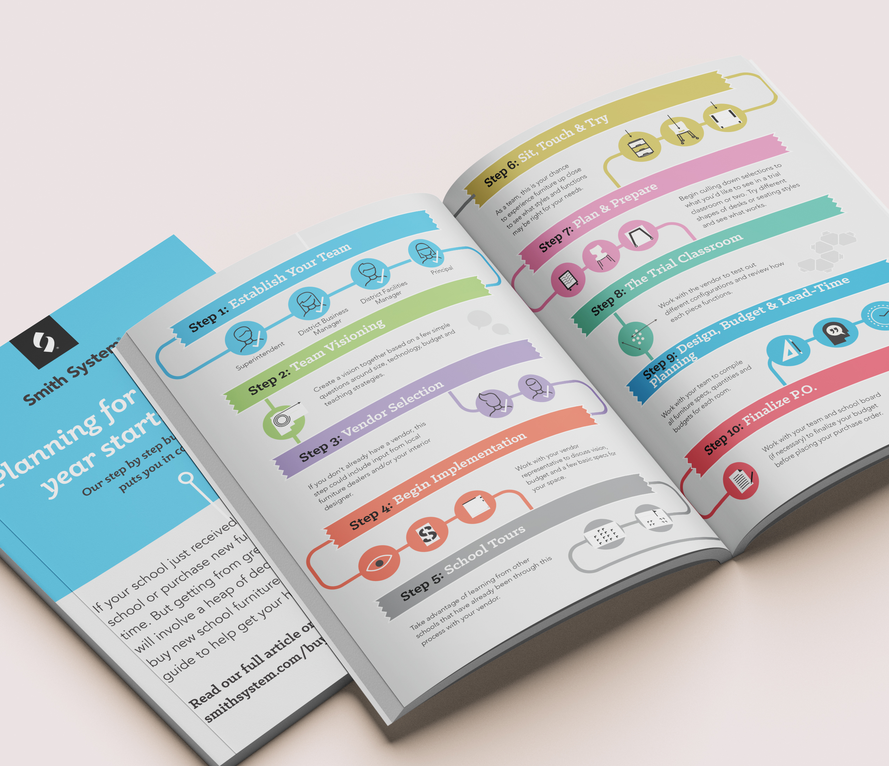
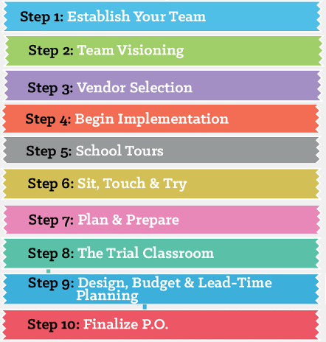
Process
Many have never gone through it! What’s involved?
Solving Problems

Slide 5
Review
Process: many have never gone through it! What’s involved?
Team: roles and responsibilities, who makes decisions?
Vision: how can you ask questions to help them articulate it, bring it to life?
Competing vendors: address it head-on, teach them how to buy?
Timeline: how long does it take? When should they start? Finish?
Budgeting: who doesn’t want help? Spaces, scope, priorities?
Field trips: where can they see successful projects just like theirs?
Sit / touch / try: how and where would they see potential solutions?
Risk: it’s a big decision. How can risk be reduced?
Design & Planning: will it all fit? Tied to budget? Lead times? Installation?
Solving Problems

Slide 6

Research & Prepare
What is the project (sounds dumb, right)?
When is the project likely to be done?
What is the size of the district?
Who is the likely decision maker? (more on that)
If there’s an architect, who? Are they friendly with us?
Have you, your organization, or partners sold to them before?
Who have they bought from in the past? (Call A/P to find out!)
What other districts are nearby, and do we have notable projects there?
WHAT PAIN ARE THEY MOST LIKELY TO HAVE?

Slide 7




Research & Prepare
Smaller Districts
Medium Districts
Large Districts
  Asst Superintendent
  Business Manager
  Facilities Manager
  Principal or Asst Principal
  Large purchases often Centralized; Purchasing, Facilities
  Smaller purchases often site-based; Principal, Asst Principal, Media Specialist
  Superintendent
  Business Manager
  Principal

Slide 8

Put On Your Marketing Hat
Thinking Like a Marketer

Slide 9

You Will Not Ignore Me!
Thinking Like a Marketer

Slide 10

We compete for their attention. What makes you notice somebody?
Be different from everybody else – they don’t “care” who you are!
Be energetic – they can’t see you but need to feel your enthusiasm!
Don’t sell them something; offer them value for free (knowledge)!
Don’t make them work; do the work for them!
Thinking Like a Marketer

Slide 11



Process & Diligence
Phone call + voicemail
Email within 15 minutes
Follow up at varied times
Reply to original email
Show up in person
After you leave…?
Process & Diligence

Slide 12
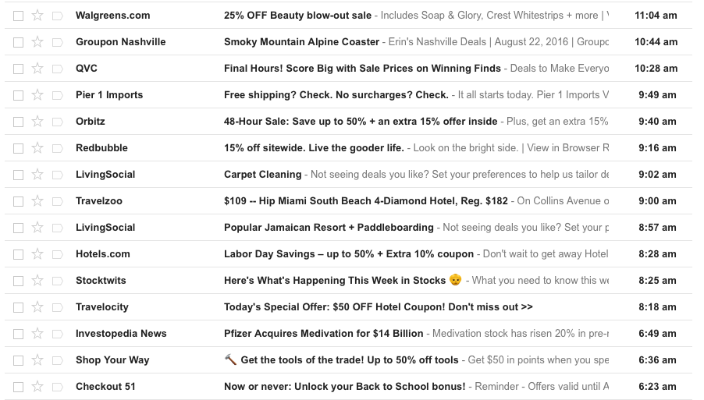
Components of Winning Emails
Your Competition,
In Part
Components of Winning Emails

Slide 13


Components of Winning Emails
The largest factor in determining whether someone opens an email is if they recognize the sender.
The people we’re contacting do not recognize us.
So, we need to stand out.
Components of Winning Emails

Slide 14
Components of Winning Emails
Each part counts!
Subject line
Get attention by using their name, ask intriguing question; make them open it
Intro
Draw out pain and communicate value proposition
“The Ask”
Use font size and bolding to draw their eye; be specific and make it easy
Content
Reinforce value proposition, give a “freebie” to generate more interest
Image
Provide immediate proof; tell the story with a pretty picture
Components of Winning Emails

Slide 15

Communication Examples
How NOT to Prospect
Subject Line: Smith System School Furniture
Hi John,
My name is Bill with Smith System and we are a leading K-12 school furniture manufacturer with successful projects all over the country. I see you are building a new school. Are you available to meet?
Our furniture is perfect for classrooms, makerspaces, STEM, commons, libraries, media centers, e-sports, outdoors spaces, and more. I could bring out samples to show you the quality. We are a mid-market price point, not too expensive, and you can choose from many different colors.
I’ve attached our full line catalog, a look book, and price list so you can learn more about us.
Hope to hear from you soon.
Best regards,
Bill
Communication Examples

Slide 16

Communication Examples
Subject Line:
Subject Line: John, Furniture Buying Process…. Thoughts?
Personalized subject line with question
Communication Examples

Slide 17
Communication Examples
Subject Line: John, Furniture Buying Process - Thoughts?
Elicit pain, establish credibility, value proposition
Intro:
Hi John,
I just left you a voicemail – that many Superintendents I speak with haven’t purchased furniture for entire schools and often feel overwhelmed by the whole process.
Superior, Waupun, Beaver Dam, and Green Bay are a few examples of recent bond projects where I’ve guided the district team through the furniture process for opening on School Day 1.
Communication Examples

Slide 18

Communication Examples
Subject Line: John, Furniture Buying Process - Thoughts?
Hi John,
I just left you a voicemail – that many Superintendents I speak with haven’t purchased furniture for entire schools and often feel overwhelmed by the whole process.
Superior, Waupun, Beaver Dam, and Green Bay are a few examples of recent bond projects where I’ve guided the district team through the furniture process for opening on School Day 1.
Brief Meeting – April 24 around 9:30am?
I’ll be in town next Wednesday. Do you have 15 minutes to discuss the process for how you might select vendors and furniture for your upcoming project?
Font size – draw eye to “the ask”
Communication Examples

Slide 19
Subject Line: John, Furniture Buying Process - Thoughts?
Hi John,
I just left you a voicemail – that many Superintendents I speak with haven’t purchased furniture for entire schools and often feel overwhelmed by the whole process.
Superior, Waupun, Beaver Dam, and Green Bay are a few examples of recent bond projects where I’ve guided the district team through the furniture process for opening on School Day 1.
Brief Meeting – April 24 around 9:30am?
I’ll be in town next Wednesday. Do you have 15 minutes to discuss the process for how you might select vendors and furniture for your upcoming project?
Below is a model I’ve used with other districts going through projects like yours:
https://smithsystem.com/smithfiles/classroom-furniture-buying-process
Reinforce value prop with “freebie”
Communication Examples

Slide 20

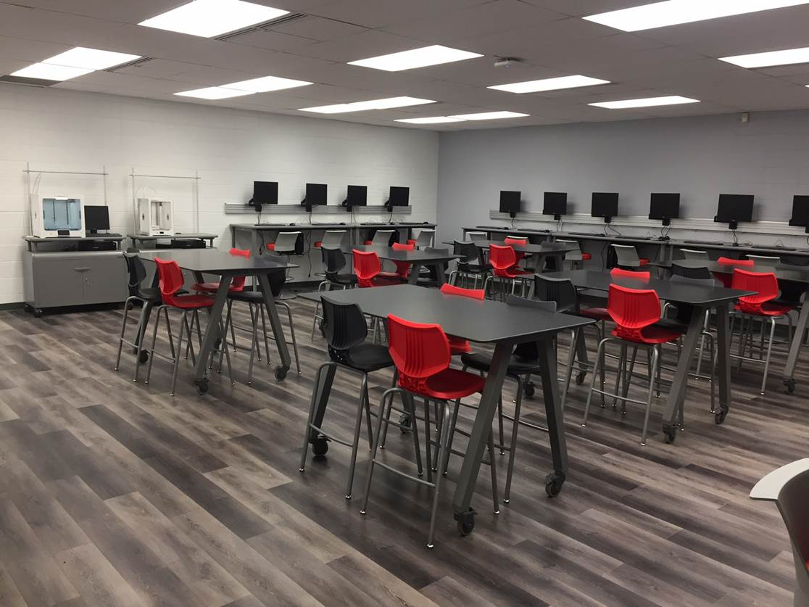
Subject Line: John, Furniture Buying Process - Thoughts?
Hi John,
I just left you a voicemail – that many Superintendents I speak with haven’t purchased furniture for entire schools and often feel overwhelmed by the whole process.
Superior, Waupun, Beaver Dam, and Green Bay are a few examples of recent bond projects where I’ve guided the district team through the furniture process for opening on School Day 1.
Brief Meeting – April 24 around 9:30am?
I’ll be in town next Wednesday. Do you have 15 minutes to discuss the process for how you might select vendors and furniture for your upcoming project?
Below is a model I’ve used with other districts going through projects like yours:
https://smithsystem.com/smithfiles/classroom-furniture-buying-process
And, here’s an example of what we do from a recent Tech Ed project in Fall River, WI:
Immediate proof, image tells the story

Slide 21

Personalized subject line with question
Subject Line: John, Furniture Buying Process – Thoughts?
Hi John,
I just left you a voicemail – that many Superintendents I speak with haven’t purchased furniture for entire schools and often feel overwhelmed by the whole process.
Superior, Waupun, Beaver Dam, and Green Bay are a few examples of recent bond projects where I’ve guided the district team through the furniture process for opening on School Day 1.
Brief Meeting – April 24 around 9:30am?
I’ll be in town next Wednesday. Do you have 15 minutes to discuss the process for how you might select vendors and furniture for your upcoming project?
Below is a model I’ve used with other districts going through projects like yours:
https://smithsystem.com/smithfiles/classroom-furniture-buying-process
And, here’s an example of what we do from a recent Tech Ed project in Fall River, WI:
Intro: elicit pain, establish credibility, value proposition
Font size – draw eye to “the ask”
Reinforce value prop with “freebie”
Immediate proof, image tells the story

Slide 22

Cold Calling
The gatekeeper.
“Do you have an appointment?”
“Yes.” – you’d be lying.
“No.” – they brush you off.
“It’s really important…” – means “No”, brush you off.
Cold Calling

Slide 23
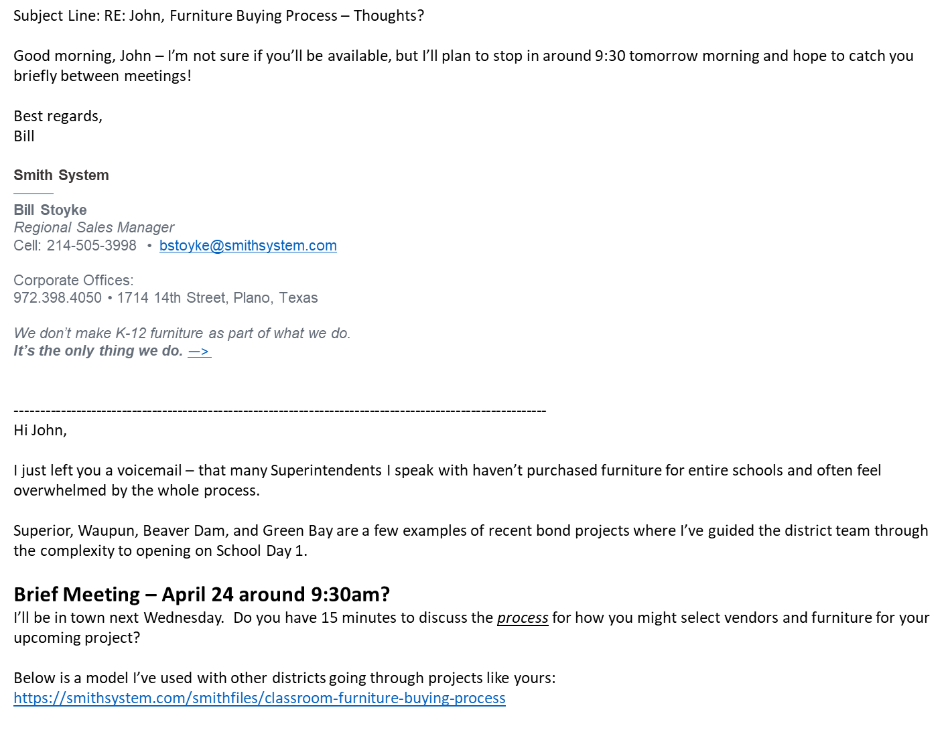
Set your cold call up for greater success the day before or day of your visit.
Or, leave a voicemail to the same effect.

Slide 24
Cold Calling
The gatekeeper.
“Do you have an appointment?”
“No, but I let them know I’d be stopping by at this time. They may be expecting me.”
Cold Calling

Slide 25

Cold Calling
“No, but I let them know I’d be stopping by at this time. They may be expecting me.”
You’re not lying and can say it CONFIDENTLY.
Cold Calling

Slide 26
Cold Calling
“No, but I let them know I’d be stopping by at this time. They may be expecting me.”
You’re not lying and can say it CONFIDENTLY.
They are not sure if the DM is expecting you.
Cold Calling

Slide 27
Cold Calling
“No, but I let them know I’d be stopping by at this time. They may be expecting me.”
You’re not lying and can say it CONFIDENTLY.
They are not sure if the DM is expecting you.
They’ll check with the DM on your behalf.
Cold Calling

Slide 28
Cold Calling
“No, but I let them know I’d be stopping by at this time. They may be expecting me.”
You’re not lying and can say it CONFIDENTLY.
They are not sure if the DM is expecting you.
They’ll check with the DM on your behalf.
Often, the DM: “Oh, I got your email – come on back.”
Cold Calling

Slide 29

Process & Diligence
If I had never shown up, I would never have gotten a response
Making eye contact and creating a personal relationship matters
You can always ask to reschedule
Leave the Buying Process with a personal note, then follow-up by email or phone
Process & Diligence

Slide 30
Process & Diligence
Subject Line: RE: Yesterday – materials received?
Hi David, sorry I missed you yesterday – but I did leave a printed copy of our new Furniture Buying Process and Timeline for you:
https://smithsystem.com/smithfiles/classroom-furniture-buying-process
Did you receive it?
Best regards,
Bill
---------------------------------------------------------------------------------------------
HI,
Yes, I'm sorry I missed you also. It was just late notice. I've looked over the catalogue and the guide you sent and it looks as though I'm going to need to make some decisions soon as we are remodeling and need the rooms open for this coming fall. The elementary wing is not as big a rush and we are not intending on replacing a lot of that furniture. The need I see for that are a few U shaped reading tables that seat about 5 and a few smaller work tables (3X5). More immediately I need some tables and chairs for a STEM room. I am also looking at a couple science tables and some possible cafeteria seating.
Perhaps we can schedule a time to meet in the not too distant future?
David
Reiterates you did what you said; asks recipient to confirm.
Process & Diligence

Slide 31
Process & Diligence
Subject Line: RE: Yesterday – materials received?
Hi David, sorry I missed you yesterday – but I did leave a printed copy of our new Furniture Buying Process and Timeline for you:
https://smithsystem.com/smithfiles/classroom-furniture-buying-process
Did you receive it?
Best regards,
Bill
---------------------------------------------------------------------------------------------
HI,
Yes, I'm sorry I missed you also. It was just late notice. I've looked over the catalogue and the guide you sent and it looks as though I'm going to need to make some decisions soon as we are remodeling and need the rooms open for this coming fall. The elementary wing is not as big a rush and we are not intending on replacing a lot of that furniture. The need I see for that are a few U shaped reading tables that seat about 5 and a few smaller work tables (3X5). More immediately I need some tables and chairs for a STEM room. I am also looking at a couple science tables and some possible cafeteria seating.
Perhaps we can schedule a time to meet in the not too distant future?
David
Pain recognized.
Sees a solution.
Wants to meet!
Process & Diligence

Slide 32
Thank you

