Slide 1

Selling into K-12:
First Meetings + Follow-up

Slide 2






Agenda
Meeting Objective
Mindset
Process
Questions to Ask
Follow-up Action Items

Slide 3
Meeting Objective
Gain their commitment to continue through the process with you. Don’t ask for more than is reasonable since they have never met you before. This is a long process and not something that can be won in one meeting.

Slide 4
Meeting Objective
Gain their commitment to continue through the process with you. Don’t ask for more than is reasonable since they have never met you before. This is a long process and not something that can be won in one meeting.
Promise to provide them something of value as a follow-up (uncover what it is from questions) – you’re doing something for them to create good will and establish credibility; namely, doing what you say when you say you will do it.

Slide 5
Meeting Objective
Gain their commitment to continue through the process with you. Don’t ask for more than is reasonable since they have never met you before. This is a long process and not something that can be won in one meeting.
Promise to provide them something of value as a follow-up (uncover what it is from questions) – you’re doing something for them to create good will and establish credibility; namely, doing what you say when you say you will do it
Make the commitment a specific action and have it be time-bound.

Slide 6
Meeting Objective
Gain their commitment to continue through the process with you. Don’t ask for more than is reasonable since they have never met you before. This is a long process and not something that can be won in one meeting.
Promise to provide them something of value as a follow-up (uncover what it is from questions) – you’re doing something for them to create good will and establish credibility; namely, doing what you say when you say you will do it.
Make the commitment a specific action and have it be time-bound.
Follow up with an email documenting what you heard from them, confirming the agreed Next Step, and asking them to re-confirm their agreement.

Slide 7
Meeting Objective
Gain their commitment to continue through the process with you. Don’t ask for more than is reasonable since they have never met you before. This is a long process and not something that can be won in one meeting.
Promise to provide them something of value as a follow-up (uncover what it is from questions) – you’re doing something for them to create good will and establish credibility; namely, doing what you say when you say you will do it.
Make the commitment a specific action and have it be time-bound.
Follow up with an email documenting what you heard from them, confirming the agreed Next Step, and asking them to re-confirm their agreement.
Deliver on your promised follow-up and document it.

Slide 8
Mindset
Research and considerations before contacting a decision maker:
Be calm; we are the experts and know more than they do about furniture.

Slide 9
Mindset
Research and considerations before contacting a decision maker:
Be calm; we are the experts and know more than they do about furniture.
Make it a conversation. Don’t be like everybody else that tries to sell products/services.

Slide 10
Mindset
Research and considerations before contacting a decision maker:
Be calm; we are the experts and know more than they do about furniture.
Make it a conversation. Don’t be like everybody else that tries to sell products/services.
Ask questions that demonstrate expertise and let them answer; it provides an opportunity to share our best practices or pitfalls (tell some quick stories that incorporate reference projects, challenges others faced and how we solved them).

Slide 11

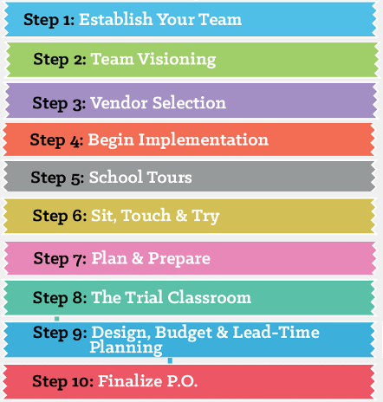
Buying Process
Most sellers talk about furniture.
We have higher-level discussions.

Slide 12
Questions to Ask
The order of questions is important; ideal if you have a 30-minute meeting. If you have 15 minutes, be prepared to adapt down.

Slide 13
Questions to Ask
The order of questions is important; ideal if you have a 30-minute meeting. If you have 15 minutes, be prepared to adapt down.
Have you ever been through a construction/renovation project before?
  What was your role in the project?
  Who led the project – you, dealer, architect?
  How well do you feel the process worked?

Slide 14
Questions to Ask
The order of questions is important; ideal if you have a 30-minute meeting. If you have 15 minutes, be prepared to adapt down.
Have you ever been through a construction/renovation project before?
  What was your role in the project?
  Who led the project – you, dealer, architect?
  How well do you feel the process worked?
How do you plan to approach the furniture vendor selection process?

Slide 15
Questions to Ask
The order of questions is important; ideal if you have a 30-minute meeting. If you have 15 minutes, be prepared to adapt down.
Have you ever been through a construction/renovation project before?
  What was your role in the project?
  Who led the project – you, dealer, architect?
  How well do you feel the process worked?
How do you plan to approach the furniture vendor selection process?
Do you have a timeline in place to get from Start to Finish?
  Opportunity to offer what you’ve seen as a reasonable amount of time to work through a project. Talk about factors that influence the timeline (pilot classroom, etc), and whether those factors may or may not be important to them.

Slide 16
Questions to Ask
Have you established a team or roles to manage the project?
  Opportunity to discuss the importance of having strong leadership to make decisions, getting buy-in from a group, and leads into the rest of the buying process.

Slide 17
Questions to Ask
Have you established a team or roles to manage the project?
  Opportunity to discuss the importance of having strong leadership to make decisions, getting buy-in from a group, and leads into the rest of the buying process.
What are some important considerations for you when choosing a vendor?
  Opportunity to educate them on key criteria and share our value proposition so they have some context of what to consider – specialize in K-12, mid-market price, high quality, deliver on-time.
  Demonstrate quality by showing top cut-out and structural framing – visuals that now set a precedent for them as “the standard” for quality, because most buyers have never considered these – now everyone else will have to live up to this measure (or not).

Slide 18
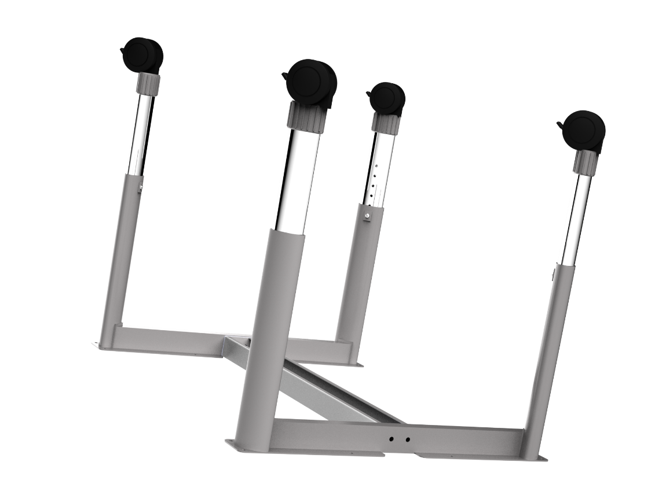
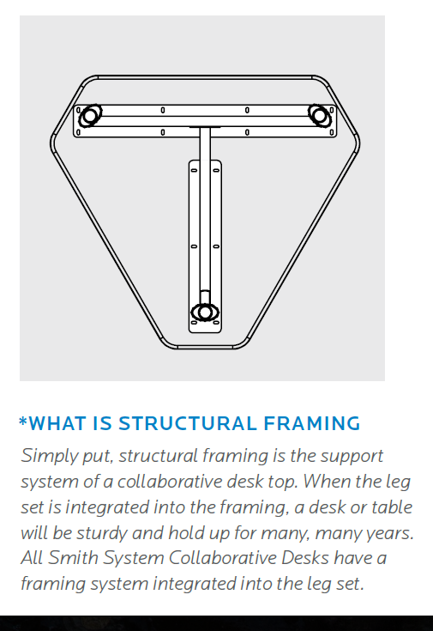
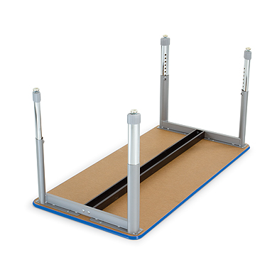
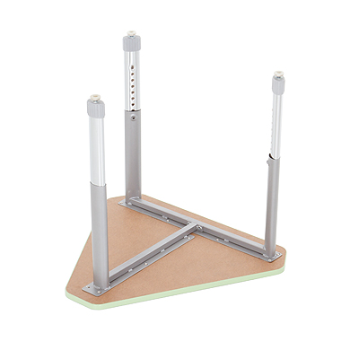
Structural Framing

Slide 19

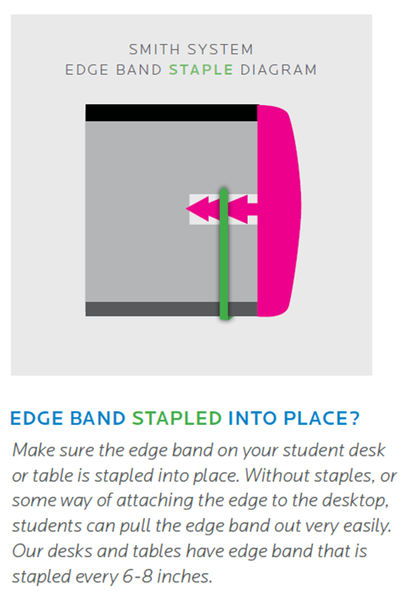
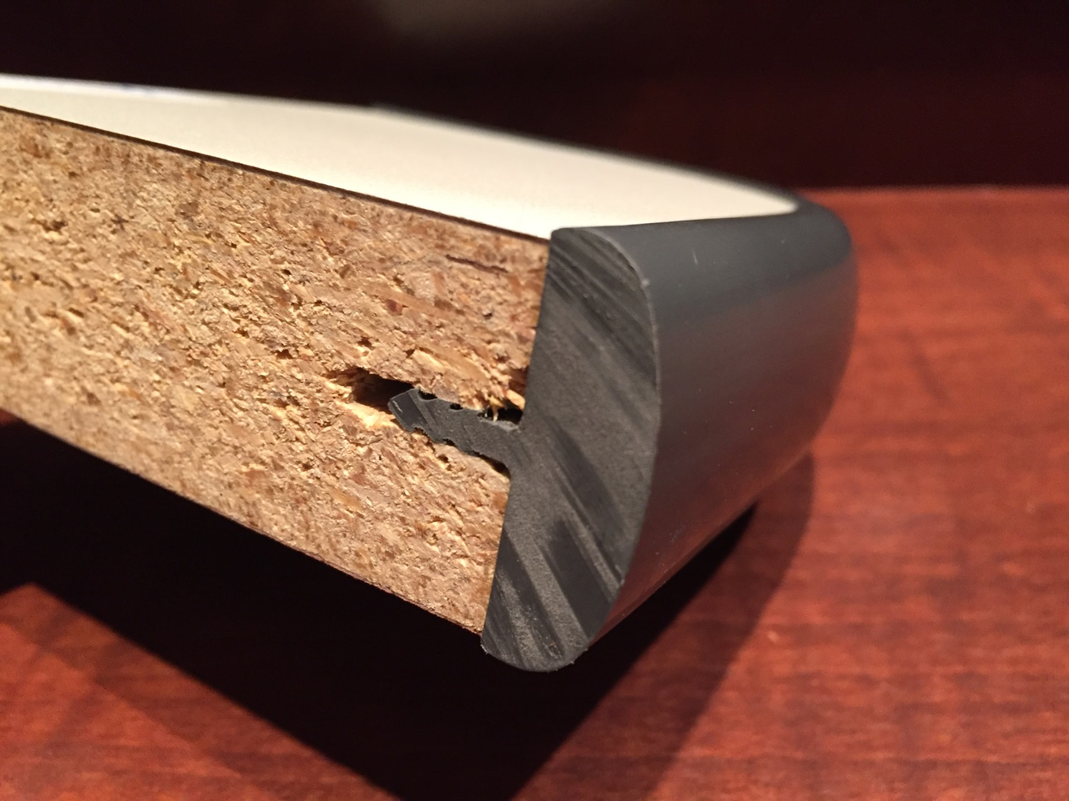
T-Mold Edge

Slide 20
Questions to Ask
Do you plan to visit other schools with similar projects to yours?
  Opportunity to name drop other successful projects nearby they could tour. Have a list prepared, or big name projects in the state they would know. Offer to send them photos as a follow-up.

Slide 21
Questions to Ask
Do you plan to visit other schools with similar projects to yours?
  Opportunity to name drop other successful projects nearby they could tour. Have a list prepared, or big name projects in the state they would know. Offer to send them photos as a follow-up.
Do you have a way to show staff the latest options and educate them on pros/cons of different styles and how they can be used?
  Opportunity to talk about a furniture fair – where you can bring products in and educate them on four key furniture categories, control what they see.
  If an event isn’t feasible, have them tour an aligned dealer’s showroom that will only have our product.

Slide 22
Questions to Ask
Do you plan to visit other schools with similar projects to yours?
  Opportunity to name drop other successful projects nearby they could tour. Have a list prepared, or big name projects in the state they would know. Offer to send them photos as a follow-up.
Do you have a way to show staff the latest options and educate them on pros/cons of different styles and how they can be used?
  Opportunity to talk about a furniture fair – where you can bring products in and educate them on four key furniture categories, control what they see.
  If an event isn’t feasible, have them tour an aligned dealer’s showroom that will only have our product.
Have you considered a pilot classroom to reduce the risk of failure?
  Opportunity to restate the importance of a furniture fair that is focused on education, so that by the time they get to the pilot furniture selection, they’re much less likely to pilot furniture that won’t work for them (increases pilot success rate and sets the design standard)

Slide 23
Questions to Ask
Do you have a target budget range per classroom?
  Opportunity to shape the conversation around priorities of four key furniture categories: student seating, student desks/tables, teacher items, mobile storage.

Slide 24
Questions to Ask
Do you have a target budget range per classroom?
  Opportunity to shape the conversation around priorities of four key furniture categories: student seating, student desks/tables, teacher items, mobile storage.
How will you tie the furniture and budget to your actual spaces?
  Opportunity to bring conversation back to larger process – why would you pilot something you can’t afford and/or that won’t fit in your new spaces?
  Offer to put together a high level timeline that would help them imagine their project – which then turns into their commitment to keep engaging you in the process, e.g. “We’ve done Step 1. Step 2 is the next logical progression – let me arrange that for you.”

Slide 25
Questions to Ask
When it comes time to actually buy the furniture, how would you procure it – bid, contract, open market?
  Opportunity to discuss contract vs bid, understand whether they will hold spec, revisit whether it will come down to price or whether they’re willing to select a partner.

Slide 26
Questions to Ask
When it comes time to actually buy the furniture, how would you procure it – bid, contract, open market?
  Opportunity to discuss contract vs bid, understand whether they will hold spec, revisit whether it will come down to price or whether they’re willing to select a partner.
  Offer to follow up with contract info (not pricing, just the contract process and piggybacking/pre-bid) to educate them that (state depending) they may not have to go out to bid because a contract is pre-bid. This solves a problem for them.

Slide 27
Questions to Ask
When it comes time to actually buy the furniture, how would you procure it – bid, contract, open market?
  Opportunity to discuss contract vs bid, understand whether they will hold spec, revisit whether it will come down to price or whether they’re willing to select a partner.
  Offer to follow up with contract info (not pricing, just the contract process and piggybacking/pre-bid) to educate them that (state depending) they may not have to go out to bid because a contract is pre-bid. This solves a problem for them.
  Can say to them…”I’ve seen districts evaluate and pilot specific pieces of furniture, become attached to it, and select it for bid based on many different factors – and then when the bid goes out, they select furniture based on only one factor which is usually price. Why go through all of that evaluation to only pick furniture based on one factor? It almost invalidates the whole process.”

Slide 28

Follow-Up Action Items

Slide 29
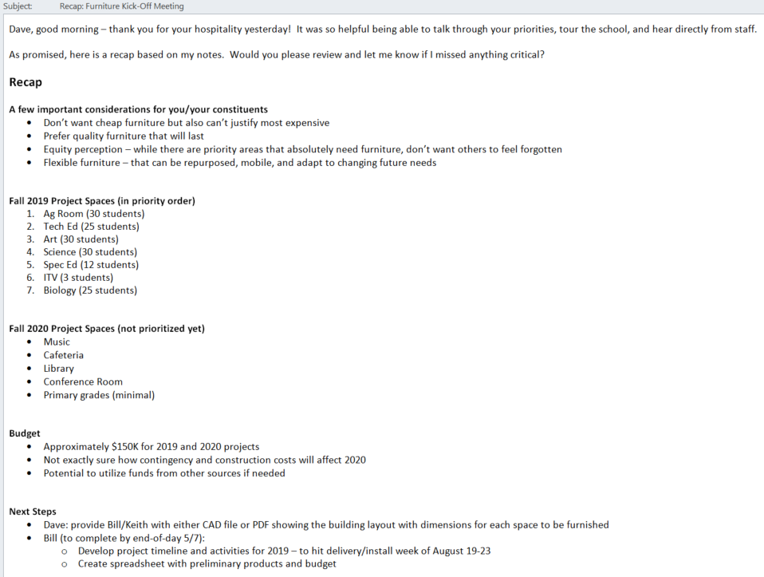

Slide 33
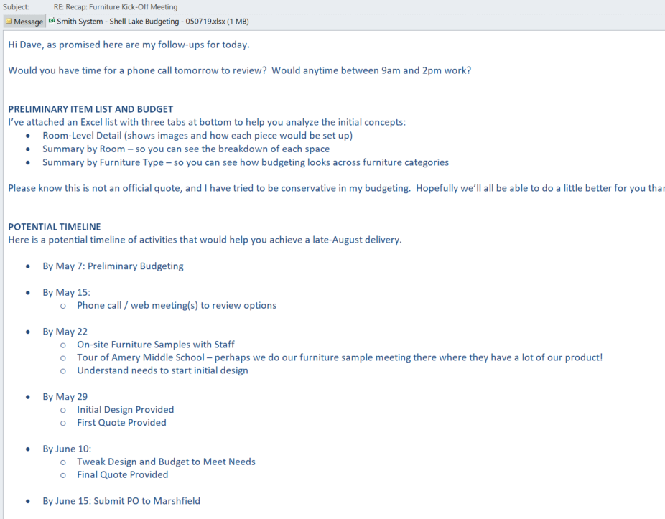

Slide 35
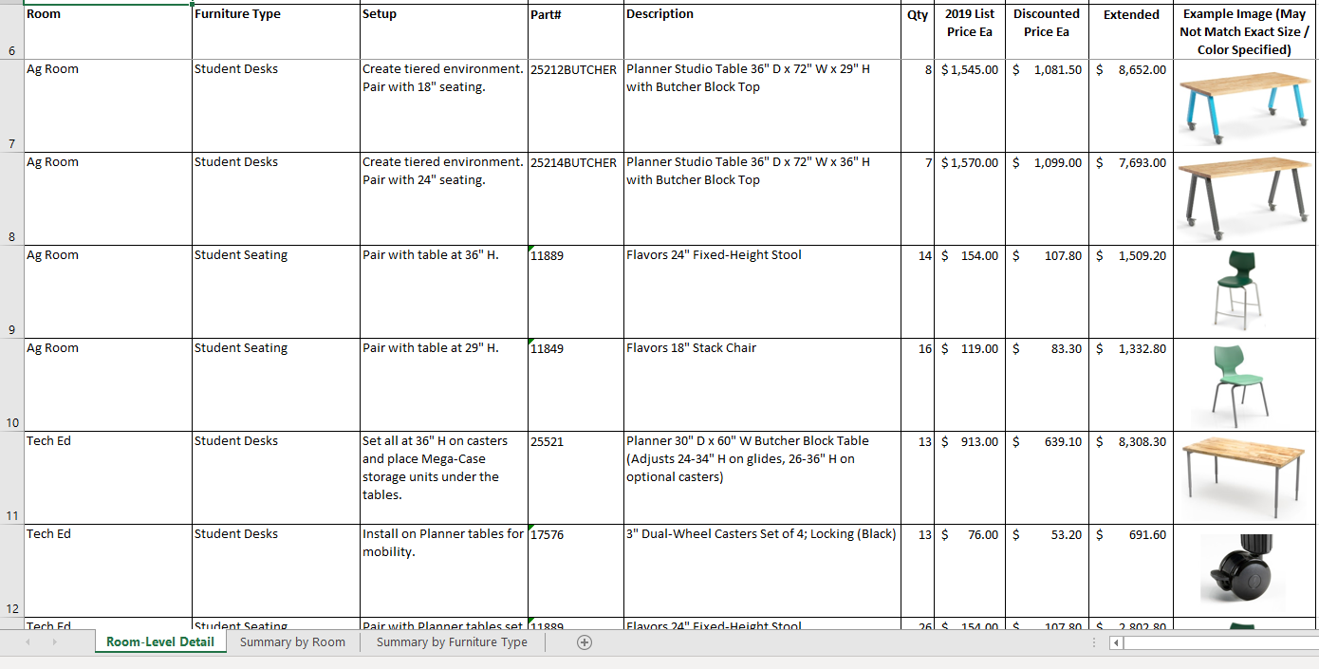

Slide 38
Notes:
Give Delivered & Installed Budgetary Price – so that freight and install isn’t an issue when formal quoting takes place.

Slide 39
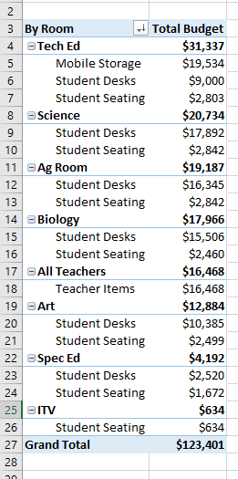

Slide 40
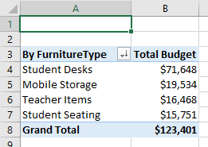

Slide 41
Review
Most sellers talk about furniture.
We have higher-level discussions.

Slide 42

Thank you

